Slide 1

INTERNET OF THINGS
Group Members:
Chris Guerra, Ankur Gandhi, Jason Han, Snehal Jadhav,
Steve Duran, Srushti Gangireddy, Tejas Ghalsasi

Slide 2
WHAT IS IOT ??
Dictionary Definition:
The Internet of Things (IoT) is the network of physical objects that contain embedded technology to communicate and sense or interact with their internal states or the external environment.
SOURCE: GARTNER 2017 (http://www.gartner.com/it-glossary/internet-of-things/)

Slide 3
WHAT IS IOT ??
· Internet of things is the system of interconnected components. Components can be computing devices, mechanical devices, digital machines. A component can be any object with an unique identifier that has the capability to transfer data over the network.
· It is a giant network of connected things and people.
· Iot allows each object in the network to be sensed and controlled remotely thereby creating direct integration between the physical world and computer based systems.
· Fields of application: home automation, transportation, health care, energy management and many other fields.

Slide 4
REASONS FOR THE STORM OF IOT
· High availability of broadband internet
· Decreased cost of processors
· Built-in wifi capability for devices.
· Decreasing costs of technology.
· Smart phone market penetration.
· Mobile data coverage has improved significantly.
· Cisco has re-defined iot as anything you can attach a sensor and connectivity can be part of connected eco-system.

Slide 5
HOW DOES IOT WORK ?
· Physical objects being connected has one or more sensors. Each sensor monitors some event/condition such as location, motion, vibration, temperature.
· These sensors connect to each other or to the system that can understand the information from the data feeds of sensors.
· Iot-enabled objects will communicate the information about specific condition or the environment around it which has people, systems and machines.
· This information can either be shared real time or at frequent intervals.
· Iot data differs from the traditional data. It would be small in size and comes at frequent intervals.
· The number of devices/nodes connected in iot would be great in number.

Slide 6
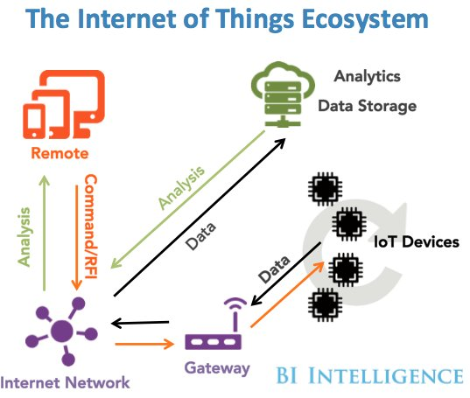
STRUCTURE OF IOT
· Iot can be viewed as a giant network of networks of devices and computers connected through a series of intermediate technologies.
· Each item would be addressable.
· Sensors in the devices act as the primary source to collect data from the environment.
· Embedded intelligence in the devices gives them the ability to connect to internet.
IMAGE: THE INTERNET OF THINGS (SOURCE: HTTP://WWW.BUSINESSINSIDER.COM/HOW-THE-INTERNET-OF-THINGS-MARKET-WILL-GROW-2014-10)

Slide 7
WHAT IOT MEANS TO BUSINESS?
· IoT impacts every business.
· Newly connected devices produce new data that can be analyzed.
· Helps business gain efficiencies, harness intelligence, improve operations and increase customer satisfaction.
· Business will have visibility into device’s condition. Both business and the consumer can remotely control the device.
· Helps save money by minimizing the failure of equipment.
· Iot helps retail businesses to see how many people are buying/ interested in buying their products.

Slide 8
MAJOR PROMOTERS OF IOT

Slide 9

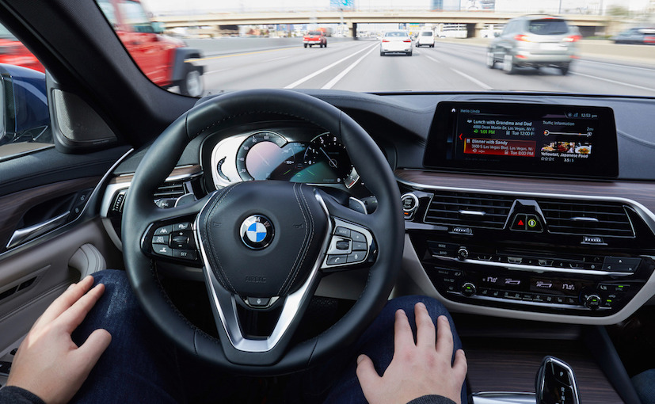
BMW
Top Luxury Car Selling company unveiled in 2017 a prototype of their 2016 series 5 model giving insight of IOT capabilities and possibilities.
Aggregated public data on traffic lights in Las Vegas
Information displayed entirely on dashboard
Displayed exact second when each light was switching
Dashboard was integrated with the system
Amazon, Opentable
Gesture Controls to the cloud
Have the car read out information to you
ex. Dinner reservation , Amazon Order

Slide 10
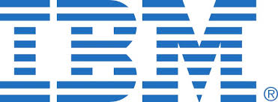
IBM
IBM and BMW partner up to create CarData Project
A new way of accessing data about your car
Mileage, Average Fuel Consumption, Event Data, Service Information and more
Information encrypted on a sim card and then transfer to IBM cloud .
Benefits
All car information at a single place
Accurate and detailed car information
Third party services
Customer control of data

Slide 11

Orbita
Healthcare, one of the fastest industry adopting IOT
Orbita has uses IOT devices like such as:
Smart phones
Wearables
Other medical devices
Medical doctors and nurses have constant attention to patients via dashboard
Benefits
Early detection of sickness or abnormalities
Health cost go down
People live a longer and live healthier life

Slide 12
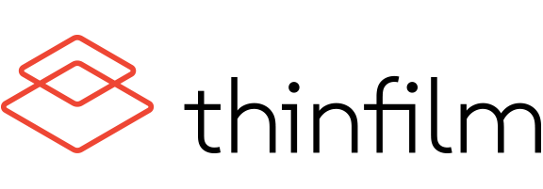
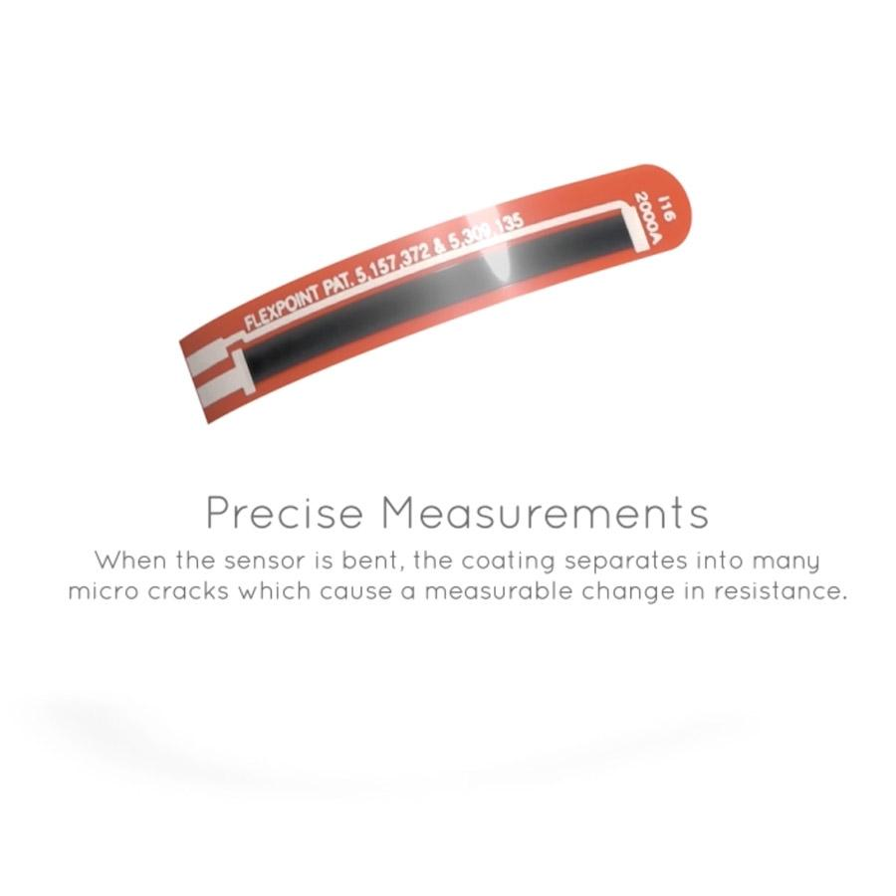
ThinFilm
IOT has allowed thinfilm to build a company that uses a sensor strip that delivers constant information about the product it is attached to.
Markets broken into:
Retail
Replacing physical tag
Shows to reduce theft in companies
Cost effect
Food Industry
Temperature tracking
Increase in health standards
All information can be seen on any mobile device.

Slide 13
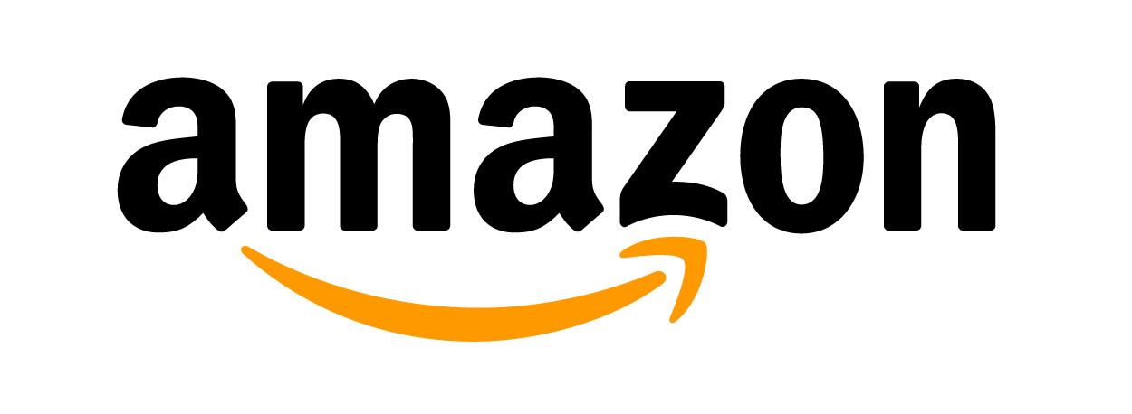
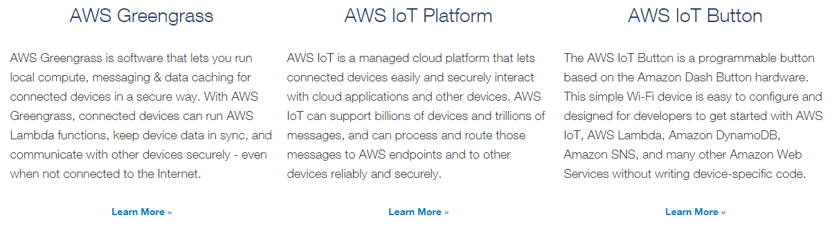
AMAZON
Amazon is a major electronic commerce and cloud computing company.
Apart from its E-Commerce Business , Amazon has extensive options for cloud computing. As AWS is open for IoT, many companies can now leverage the power of IoT on top of their existing business.
The following are the Amazon offerings for IOT

Slide 14
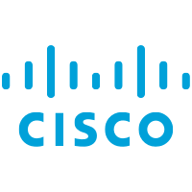
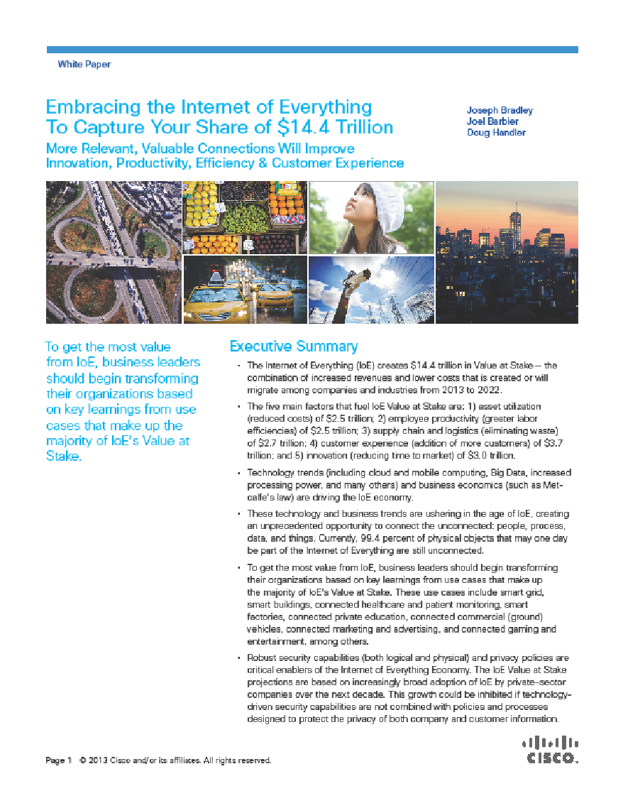
CISCO
CISCO is a major company in Hardware electronics and technology. It has a significant contribution to IOT
Cisco investments allocates $150 million to fund early-stage firms around the globe[ref]
Cisco has published White Paper on IoT on its ability to gather, analyze, and distribute data

Slide 15
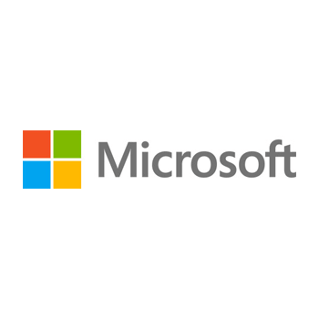
MICROSOFT
Microsoft has its cloud setup on azure. They have enabled azure iot suite [- azure iot suite overview]
Windows also has their own iot dashboard and software ie windows 10 for iot.
Windows developer program for iot - github site
Nadella says windows 10 will tie everything together in the iot

Slide 16
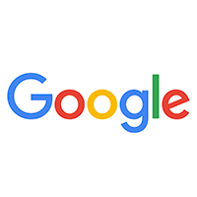
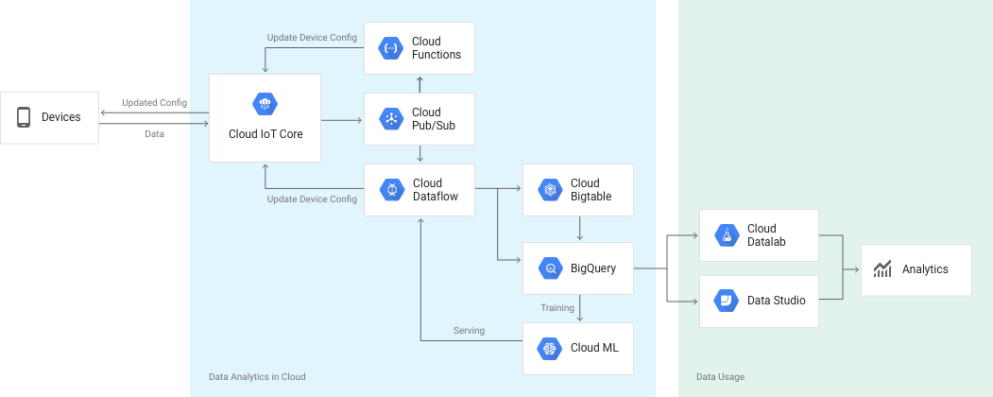
GOOGLE
Google paid $3.2 billion for thermostat startup Nest.[Ref.] . This puts google ahead of its competition.
On the Business side google said that its combination of back end fiber optics network combined with its massive public cloud infrastructure is going to boost IoT.
Google has its own Cloud IoT platform. [https://cloud.google.com/solutions/iot/]

Slide 17
Open Source IoT Projects

Slide 18
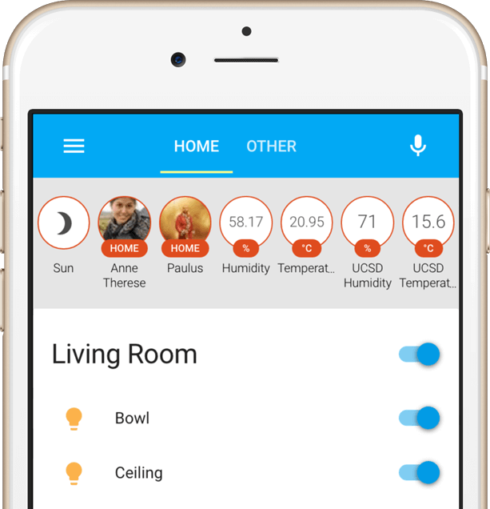
Home Assistant
Home Assistant is an open-source home automation project that runs on Python 3.
Can be installed on a home computer or Raspberry Pi.
Works with already existing smart devices and products such as Amazon’s Echo/Alexa, Nest, Google Cast devices such as Android TVs and Chromecasts, and Apple TV.
Provides a privacy focused alternative to home automation without cloud-based data storage.
Users can download or submit programs to control various devices.

Slide 19
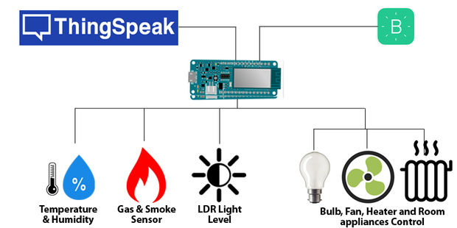
ThingSpeak
Application Programming Interface and application to store and retrieve data
Aggregate, visualize, and analyze live data streams in the cloud
Perform data analysis and process using integrated MATLAB support
Currently in use to perform energy data analysis, tide prediction, and traffic and weather monitoring

Slide 20
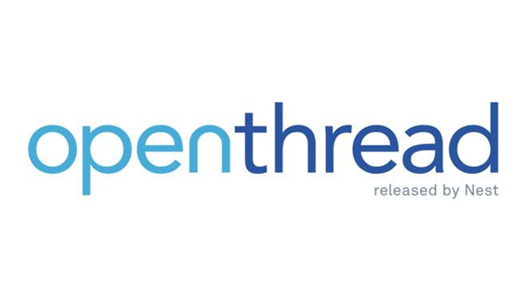
OpenThread
Open source implementation of Thread home automation networking protocol.
Project backed by Nest Labs, Qualcomm, Samsung, and many other major companies to accelerate development of smart home technology.
Developers can access the source code and file issues through GitHub, distributed by Nest and with support on Stack Overflow.

Slide 21
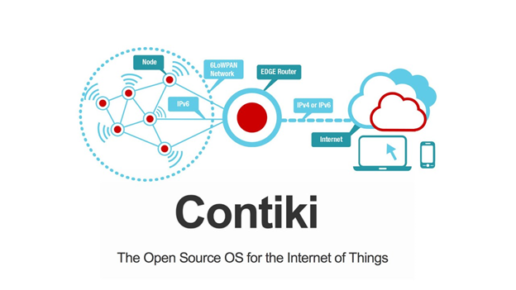
Contiki
Open source operating system designed for low-cost, low-power devices with only a few kilobytes of storage.
Connects low-power devices to the internet.
Supports many wireless standards including IPv4, IPv6, 6lowpan, RPL, and CoAP.
Full source code is available, and can be used in both commercial and non-commercial systems.

Slide 22
Group Comments

Slide 23
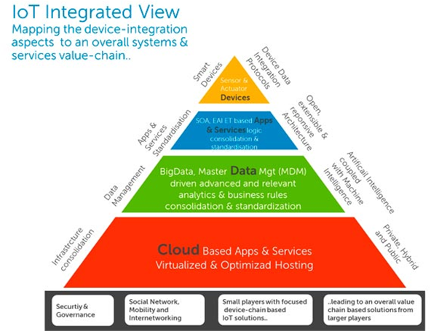
Future Trends
•Platforms
•Standards and Ecosystems
•Event Stream Processing
•Operating System
•Low-Power, Wide-Area Networks
•Device Management
•Analytics

Slide 24
IoT Effects in Business
•In the IoT era, new models such as subscriptions, freemiums and bundles are rapidly becoming the preferred choice over traditional hardware options. Services are easily upgradeable, much more amenable to ecosystems that are constructed around hardware, and provide multiple revenue opportunities rather than a one-time sale
•The premise of the IoT is that, at any given time, devices can transmit data to and from one another and process it to improve decision-making.
•cloud and the customer experience -IoT will continue to increase the amount of data businesses need to process.

Slide 25
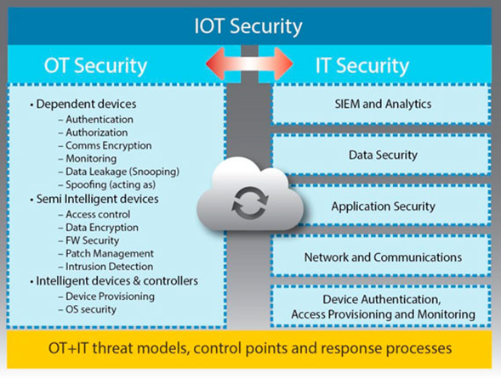
Security Challenges
•The IoT introduces a wide range of new security risks and challenges to the IoT devices themselves, their platforms and operating systems, their communications, and even the systems to which they’re connected
•IoT security will be complicated by the fact that many ‘things’ use simple processors and operating systems that may not support sophisticated security approaches

Slide 26
Security Challenges
•The downside of the IoT is that more data and more connected devices mean more opportunities for hackers and cybercriminals to launch an attack.
•With fully automated security systems, someone could break in, lock all the systems, and even remotely turn the lights on before they get there. These are very real risks
•Everyone will benefit [from the IoT], but unlike other technologies, this has a great deal more risk. The best course of action here is to proceed with caution

